Slide 1


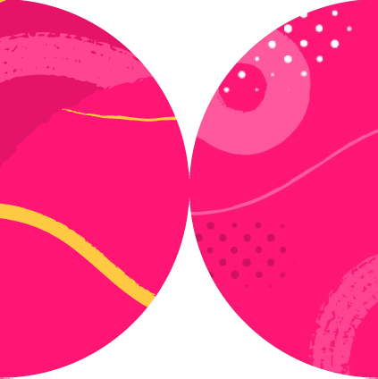

Using Playwright Basic Actions

Slide 2

Overview
Navigating and its options
A great variety of clicking Fill, check, select, press Verifying the result

Slide 3


Navigation Life Cycle
Navigation:
Ends when response headers parsed
Loading (shortened):
document content is loaded over network
and parsed
Page.onDOMContentLoaded(handler) event is fired
page executes some scripts and loads resources like stylesheets and images
Page.onLoad(handler) event is fired
Fastest
Balanced
_{Slowest} - page executes dynamically loaded scripts
- ‘networkidle’ fired after 500ms of no traffic

Slide 4
locator.click();
locator.click(new Locator.ClickOptions().setClickCount(2)); locator.click(new Locator.ClickOptions()
.setButton(MouseButton.RIGHT));

Slide 5
Predictable and consistent public API indicates a well-thought-out design

Slide 6
.fill()
VS
.type()
Does NOT clear the input
Sends “keydown-keyup” keyboard events for every character
Slower locator.type()
page.keyboard.type()
Clears the input Sets the input value Very fast

Slide 7
locator.selectOption(“red”);
<select multiple>
<option value="red">Red</option>
<option value="green">Green</option>
<option value="blue">Blue</option>
</select>
locator
.selectOption(new SelectOption()
.setLabel(“Blue”));

Slide 8
locator.hover(); locator.dragTo(another_locator);
locator.press('Control+ArrowRight'); locator.press('Shift+A');

Slide 9
Navigate, reload, goBack, goForward
Summary
Configurable
Clicking, filling, checking, selecting, etc.
Configurable
locator.type(), page.keyboard().type() innerText()
hasValue() vs. hasText()

